Slide 1
CSE308:COMPUTING PRACTICUM-IV
Unit 6: Managing Basic Storage and Logical Volumes
• Adding Partitions, File Systems, and Persistent Mounts
• Managing Swap Space
• Creating Logical Volumes
• Extended Logical Volumes
Outcome: Compare various methods to manage partitions, file systems, swap spaces from the command line

Slide 2
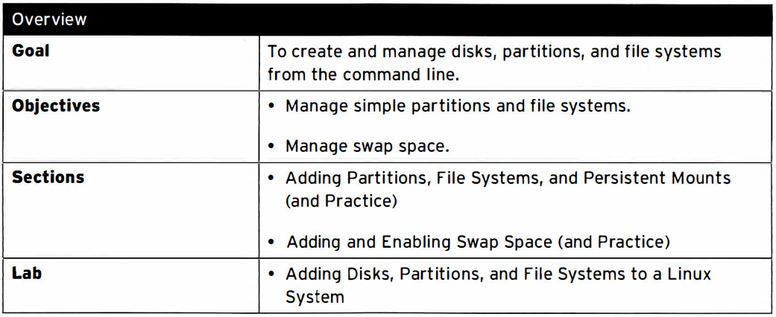
Managing storage

Slide 3
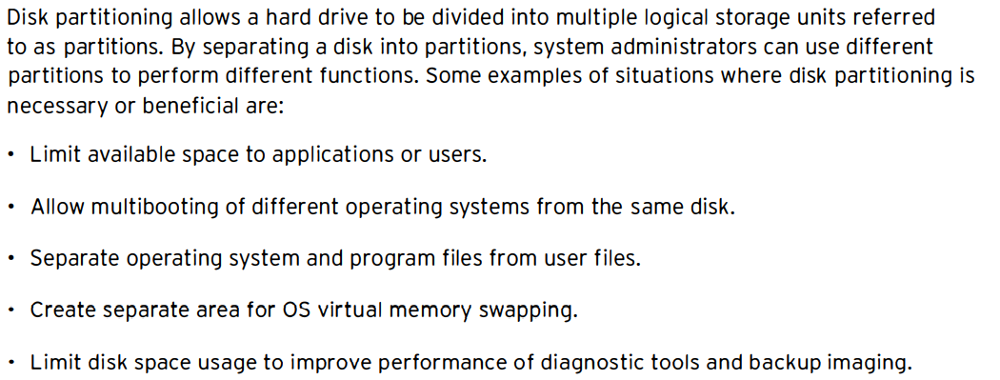
Disk Partitioning

Slide 4
MBR Partitioning scheme
Since 1982, the Master Boot Record (MBR) partitioning scheme has dictated how disks should be partitioned on systems running BIOS firmware.
This scheme supports a maximum of four primary partitions.
On Linux systems, with the use of extended and logical partitions, administrator can create a maximum of 15 partitions.
Since partition size data are stored as 32-bit values, disks partitioned with the MBR scheme have a maximum disk and partition size limit of 2 TiB.

Slide 5
GUID Partition Table (GPT) for disk partitioning
For systems running Unified Extensible Firmware Interface (UEFI) firmware, GPT is the standard for laying out partition tables on physical hard disks.
GPT is part of the UEFI standard and addresses many of the limitations imposed by the old MBR-based scheme.
Per UEFI specifications, GPT defaults to supporting up to 128 partitions.
Unlike MBR, which uses 32 bits for storing logical block addresses and size information, GPT allocates 64 bits for logical block addresses.
This allows GPT to accommodate partitions and disks of up to 8 zebibyte (ZiB), or 8 billion tebi bytes.

Slide 6
Storage Devices
A physical component that can record data and hold it persistently.
Types:
Hard disk drive (HDD)
Solid-state drive (SSD)
USB thumb drive
External storage drive

Slide 7
File systems
A data structure that is used by an OS to store, retrieve, organize and manage files and directories on storage devices.
Types:
FAT, ext2, ext3, etx4, XFS, NTFS

Slide 8
Linux File System
We cannot create files and directories directly in the partition.
Before we use a partition for data storage we need to create a file system on it.
File system is a logical container that is used to store the files and directories.
We can create a separate file system type in each partition or can use same file system type in all partitions.
Each partition must be formatted with file system before it can be used for data storage. RHEL supports several file system types.

Slide 9
Linux File System
1. EXT (Extended File system)
This is the first Linux file system. It was used in early versions of Linux. It has been removed from RHEL.
2. EXT2 File System
This is the second generation of EXT file system. It provides very basic features of file system.
It was developed in 1980. It was the default file system before RHEL5. (It has been deprecated in RHEL7 and would be removed in next version.)

Slide 10
Linux File System
3. EXT3 File System
This is third generation of EXT file system. This was the default file system in RHEL5. It includes several enhanced features.
It supports file systems up to 16TB in size.
It supports file up to 2TB in size.
It supports up to 32000 subdirectories.

Slide 11
Linux File Syste
4. EXT4 File System
This is fourth generation of EXT file system. This was the default file system in RHEL6.
It supports file systems up to 1EiB.(1024-Exbibyte)
It supports file up 16TiB in size.
It supports unlimited directories.
5. XFS (X-File System) File System
This file system was developed by Silicon Graphics for their version of UNIX.
This is the default file system in RHEL 7. This file system is 64-bit.
It supports file systems and files of sizes up to 8EiB.
6

Slide 12
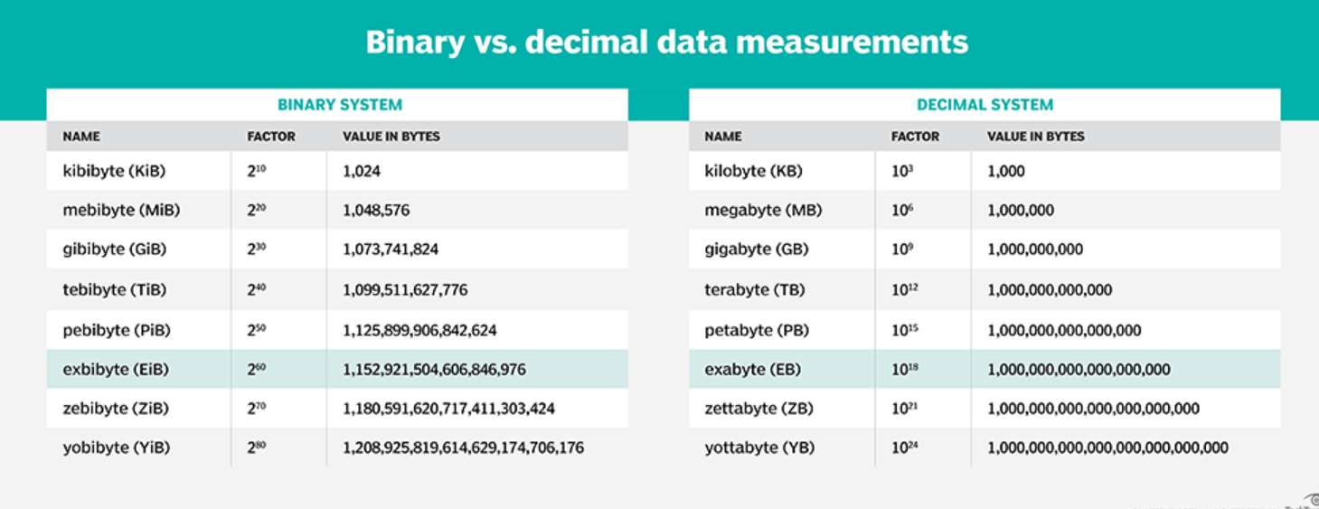

Slide 13
Linux File System
6. VFAT (Virtual File Allocation Table) File System
This is the enhanced version of FAT file system. It was developed in 1995 for Windows95. Linux does not use this file system for any operation but if require it can read and write files written in this format. This support was added in Linux so a user can exchange data between Linux and Windows using an external device such as USB drive or compact disk.
7. NTFS File System
This is the enhance version of VFAT. This file system is the default file system in Windows system. Just like VFAT, Linux can read and write files written in this format but it does not use this format for its own purpose.

Slide 14
Partitions
Dividing the large drive into smaller manageable chunks, leading to better organization of information.
A partition must be formatted and assigned a file system before data can be stored on it.

Slide 15
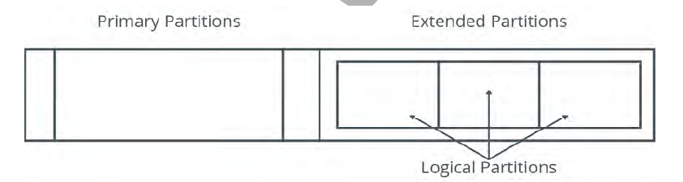
Types of Partitions
Three types of partitions:
Primary, extended and logical

Slide 16
Types
Primary Partition: A partition that can contain one file system or logical drive. A user can create only four primary partitions
Extended Partition: A partition that can contain several file systems. There can be only one extended partition which can be further sub-divided into logical partitions.
Logical Partitions: It is created within an extended partition. There is no restriction of logical partitions but advisable is 12 logical partitions per drive.

Slide 17
How to add Virtual Disk (VMWare)
Virtual disk is required to perform partitioning and create volumes.
lsblk (to view list of all disks and partitions)
Start your vmware
Click on edit virtual machine
Click on add
Click on memory
Click on SCSI
Click on “create a new virtual disk”
Select a size and Name it
Finish and start the system

Slide 18
How to add Virtual Disk(Virtual Box)
Virtual disk is required to perform partitioning and create volumes.
lsblk (to view list of all disks and partitions)
Select virtual machine and machine must be off
Click settings then storage then can see disks
Click on controller “+” button
Click on Create and Next
Specify size and create
Click on choose and OK
New Disk added and check in your system

Slide 19
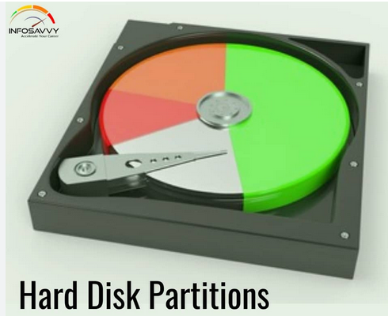
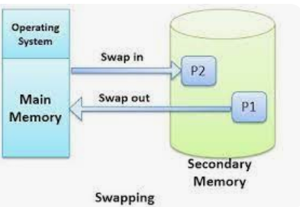
Manage Partition and Swap Space

Slide 20
Create a partition part1 of 1 Gb?
ls /dev (Check out for the entries here)
lsblk
fdisk /dev/DiskName
Command m for help: then press n Enter and you will see various options
Now choose p
Then choose number from 1 to 4

Slide 21
Create a partition part1 of 1 Gb?
Then press enter and ask for sector +1G
Created a new partition 1 of type Linux
Then update the partition table Press w
And now you are on prompt
Use partprobe /dev/DiskName
Lsblk
and check the new partition

Slide 22
Mount the partition at some mount place?
Create a mount point or as per given mount part
mkdir /newDisk (We cant add or delete content before mounting)
mkfs.xfs /dev/sdb1 (is formatted with xfs and ready to work)
mount /dev/sdb1 /newDisk/ (Mounting is done but not persistent)
Then have to update the file also
Vim /etc/fstab
And add /dev/sdb1 /newDisk xfs defaults 0 0
Mount –a (if no error then everything is done)

Slide 23
Swap Space
It is used when system runs out of physical memory.
Linux keeps some of the unused files from RAM to the swap space to free up memory.
Usually swap space should be double the RAM capacity.

Slide 24
Add a swap partition of 750. Do not delete the existing swap space?
free –m (to check for the current swap)
fdisk /dev/sdb
Then press n and the fill default number
Give size +750M
Change the type press “t”
And enter the number I have added before e.g. 2 or 3
Add hex code by pressing “L”

Slide 25
Add a swap partition of 750. Do not delete the existing swap space?
Select 82 from list type “82”
Done w
Partprobe /dev/sdb (if no error then everything is fine)
lsblk
mkswap /dev/sdbswap (to format)
Vim /etc/fstab
Add “ /dev/sdbswap swap swap defaults 0 0” Save it
swapon –a ( no error everything is done)
free –m ( and can check size is increased)

Slide 26
Advantages
To install multiple OS on same HDD.
To enhance the data security.
Better HDD space utilization.

Slide 27
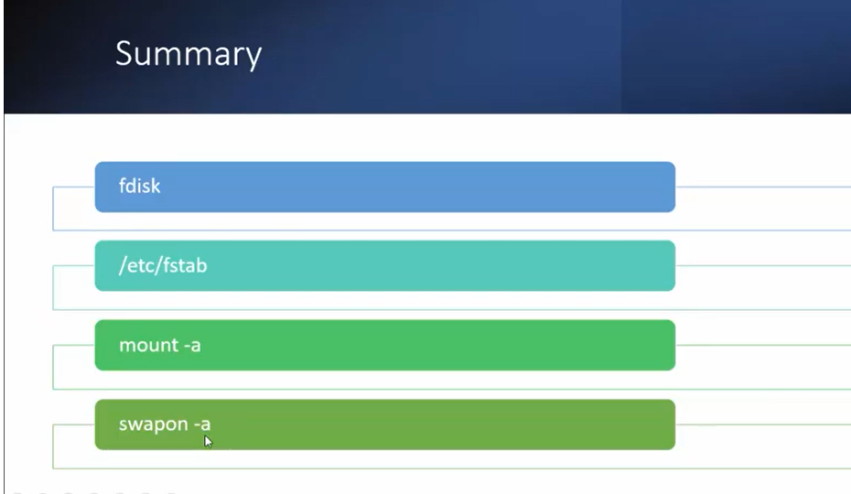

Slide 28
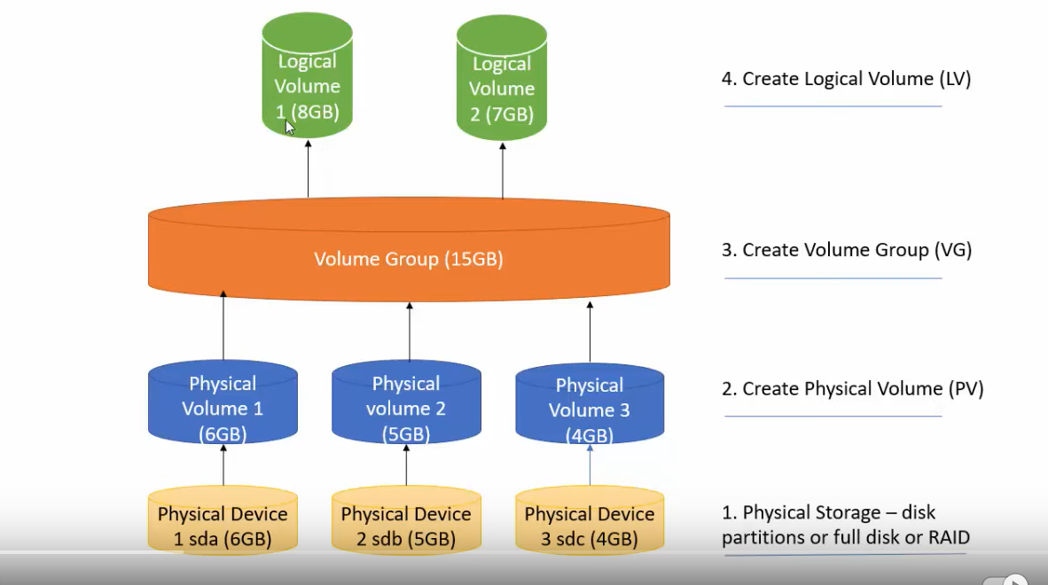

Slide 29
Logical Volume Management
Create a LV name LV2 of size 2GB
Extend the LV,LV1,LV2 by 4GB
Create a LV named LV3 with 10 extent where the size of each extent is 16MB

Slide 30
Create a LV name LV2 of size 2GB
lsblk (Before hand we need three virtual disks of size 5 Gb e.g. disk1 disk2 disk3 )
pvcreate /dev/disk1 (to convert disks into physical volume)
Repeat the above step for all three disks
pvs(to check the physical volumes in the system)
Next is to club all in one volume group
vgcreate VG1 /dev/disk1 /dev/disk2 (Adding two disks)
vgs (to check whether the volume group is created or not)

Slide 31
Create a LV name LV2 of size 2GB
Now we can create n number of logical volumes from this volume group
Lvcreate –L 2Gb –n LV2 VG1
Lvs(to check for the logical volume)
Next step is to mount it.
Vim /etc/fstab
Add “/dev/VG1/LV2 /mountpoint xfs defaults 0 0” Save and exit
Mkdir /mountpoint (to create a mount point)
Mkfs.xfs /dev/VG1/LV2
Mount –a (to check for errors)

Slide 32
Extend the LV2 by 2GB(First case)
Firstly we need some space in volume group
vgs (to check the available space)
Lvs (to check the size of logical volume)
Lvextend –r –L +2Gb /dev/VG1/LV2
Lvs (to check the size of logical volume)

Slide 33
Extend the LV2 by 2GB again(Second case)
Firstly we need some space in volume group
vgs (to check the available space, if space is not present in volume group then firstly we need to extend the volume group)
Vgextend VG1 /dev/disk3
Vgs (to check for available space)
Go to previous slide and follow the same steps to do the task

Slide 34
Create a LV named LV3 with 10 extent where the size of each extent is 16MB
How to see extents
Vgdisplay (to check the information about volume group,you can check here PE size)
Vgcreate –s 16M VG1 /dev/disk3
Vgdisplay (Now check for extent size)
Lvcreate –l 10 –n LV3 /dev/VG1
Lvs (Now check for the size)

Slide 35
How to delete logical volumes and volume groups
Vim /etc/fstab (Comment the given logical volume)
Umount /mountpoint
Lvchange –an/dev/VG1/LV2 (disable the logical volume)
Lvremove /dev/VG1/LV2
Lvs (to check the logical volumes)
Vgremove VG1

Slide 36
fdisk menu options
n: Create a new partition.
d: Deletes a partition.
p: Prints/Lists the existing partitions.
w: For saving or writing the changes.
q: Cancel the changes made.

Slide 37
The ‘partprobe’ command
It is used to update the newly modified partition table.
The command first checks the partition table, if there is any changes, it automatically updates the kernel with the changes.

Slide 38
The ‘mkfs’ command
To build Linux file system on a device.
Synatx:
mkfs.{file system type} {device name}
Example:
mkfs.ext4 /dev/sda1

Slide 39
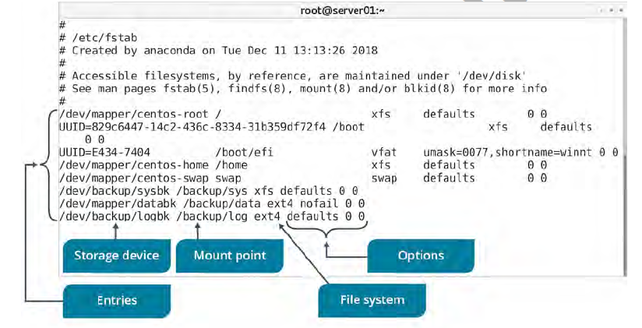
The ‘fstab’ file
A configuration file that stores information about storage devices and partitions and where and how the partitions should be mounted.
The fstab file is located in /etc directory

Slide 40
Mount Points
A mount point is an access point to an information stored on device.
The mount command: Loads a file system to a specified directory so that it can accessible to the user.
Syntax:
mount {device name} {mount point}

Slide 41
The ‘umount’ command
After using the mounted file system, it can be disconnected from the directory by unmounting the file system using umount command.
Synatx:
umount {mounting point}

Slide 42
Steps
fdisk /dev/sdb
n : new partition
p : primary
1
Start block: 2048
End: +512M
p : to print partition table
w : to write partition
partprobe /dev/sdb

Slide 43
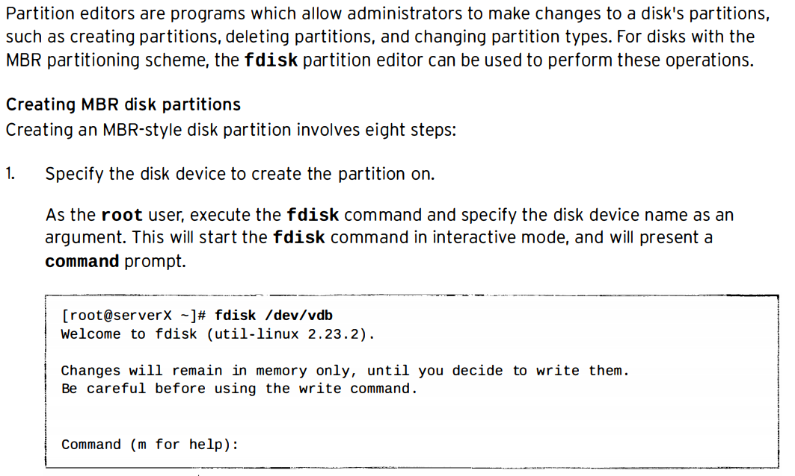
Managing MBR partitions with fdisk

Slide 44
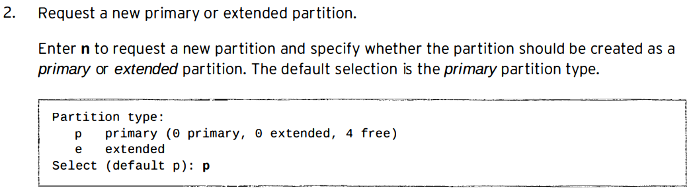
Managing MBR partitions with fdisk

Slide 45
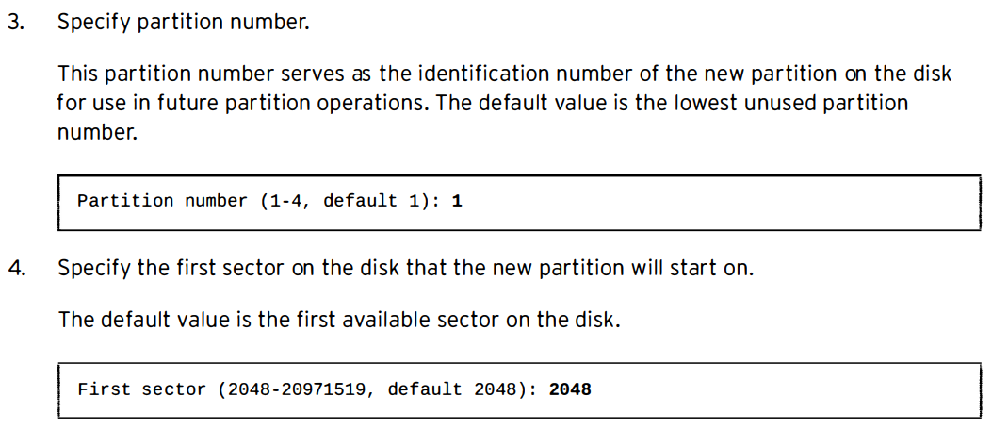
Managing M BR partitions with fdisk

Slide 46
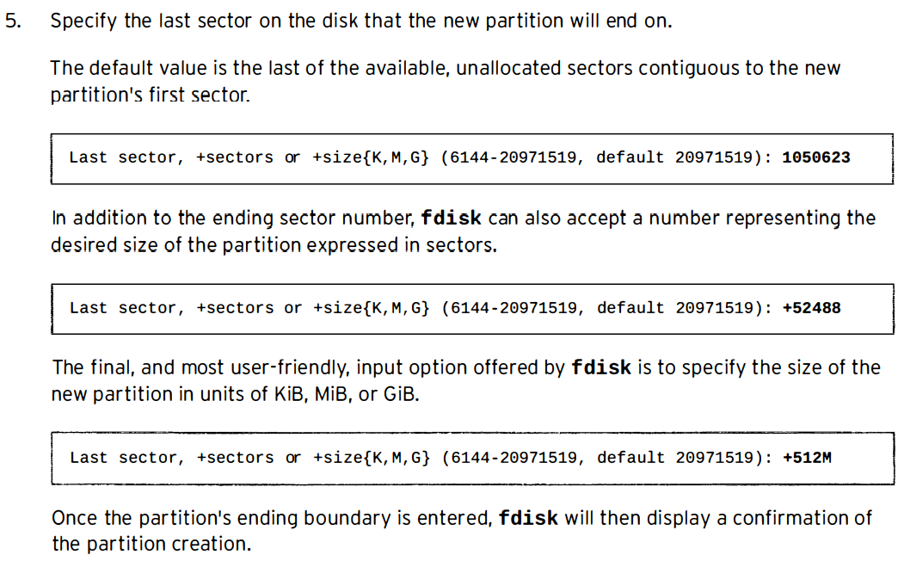
Managing MBR partitions with fdisk

Slide 47
6. Define partition type
If the newly created partition should have a type other than Linux, enter the ‘t’ command to change a partition's type.
Enter the hex code for the new partition type. If needed, a table of the hex codes for all partition types can be displayed with the “L” command.
Setting the partition type correctly is crucial, since some tools rely on it to function properly.

Slide 48
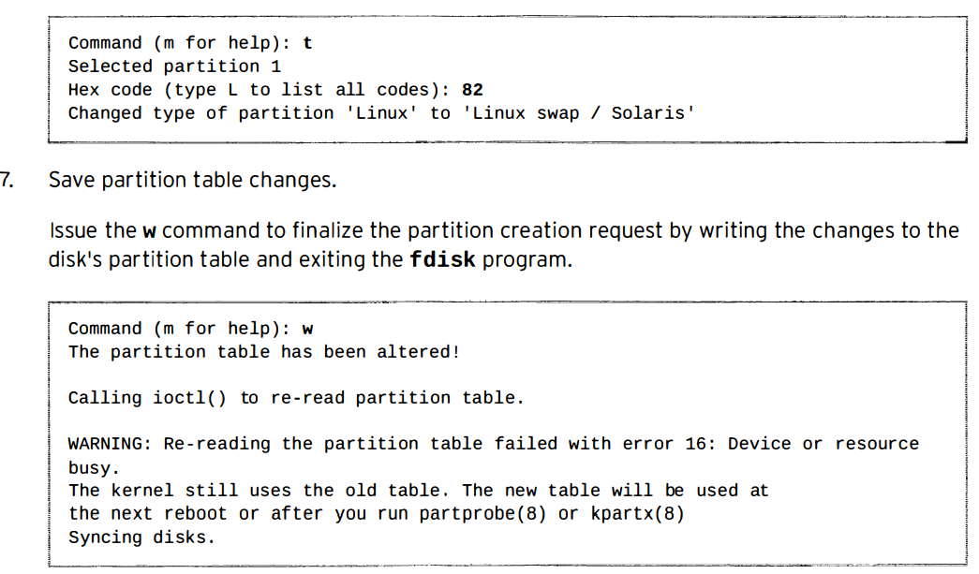

Slide 49
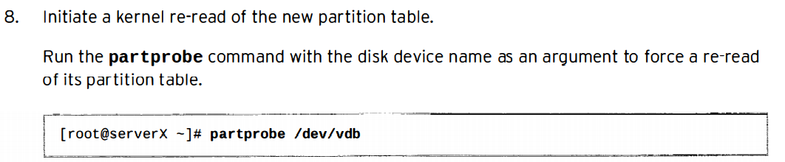

Slide 50
Use fdisk for drives that are < 2TB
parted or gdisk for disk > 2TB.
For disks < 2TB you're often using MBR (Master Boot Record).
For disks > 2TB you're using GPT (GUID Partitioning Table).

